Slide 1
The Second Machine Age: Book Review
By Grace Van Farowe

Slide 2
The Authors
Erik Brynjolfsson, who at the time of publication was the director of the MIT Initiative on the Digital Economy
Andrew McAfee, a principal researcher at this Initiative.
In their book, they approach data science from an economic viewpoint.

Slide 3
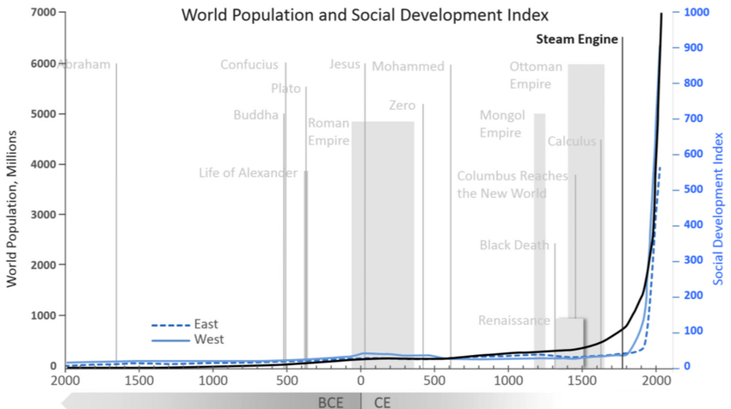
The arc of Progress: Exponential Growth

Slide 4
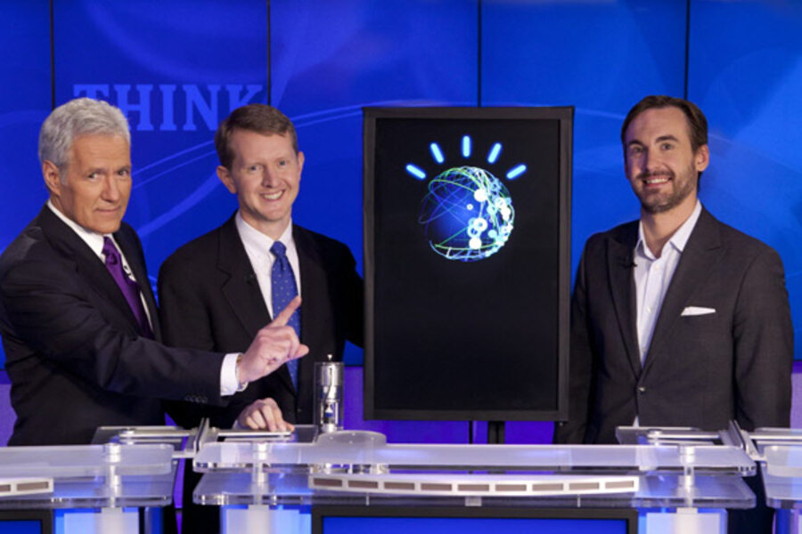
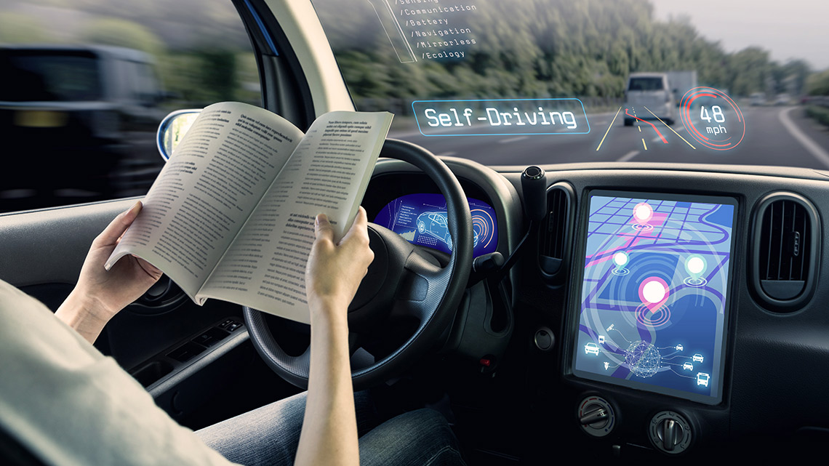
Technology of The second Machine Age
AI does jobs many thought were reserved for human higher intelligence
Many “lower level” human jobs like janitorial work are harder for machines to replicate
“We’re going to see AI do more and more, and… our lives will get better”

Slide 5
Growth and Digitization
Moore’s Law means digital storage grows exponentially cheaper
Everyone is creating free data, and this allows for free services like Google Maps to provide free services… and harvest huge amounts of data
The authors call this “bounty.”
Our good ideas can come together online, like through Kaggle competitions
Free services create value that is hard to measure economically

Slide 6


Spread: Who Gets The Bounty?
The camera company Kodak once had 145,000 employees but went bankrupt in 2012.
At the time the book was written, Instagram only employed 4,600.
Instagram needs a lot less employees, generally higher skilled.
Wages stagnate for many Americans while a few skyrocket in wealth.

Slide 7
The Luddites
The 19th century Luddites were English mill workers who vandalized machines that they believed threatened their jobs.
The authors compare them to modern economic pessimists who think automation will lead to net job loss.
They quote a panel of economists who argue that technical change will lead to increased production, and thus greater labor needs.

Slide 8

Solutions For Inequality
Better education, fueled by technology and research-backed teaching methods
Entrepreneurship, which they say seems to be the only factor creating American jobs
Crowd-sourced solutions to scientific problems and prizes for scientific discovery
Immigration reform
“Better taxing”… they propose a lot of possible solutions

Slide 9

Into The Future
Dystopia like in 1984 or the Matrix is possible
But to paraphrase MLK, the arc of history bends towards justice
The future we get will depend on the choices we make
Fewer constraints; values matter more than ever
Technology is not destiny. We shape our destiny.

Slide 10
Response And recommendation
This book ties into this class and Calvin’s values of justice and equality
I wish the authors had focused more on data privacy concerns
The perspective is somewhat utilitarian, with economic growth and human progress seen as the ultimate good.
Luke 12:15 says “Take care, and be on your guard against all covetousness, for one's life does not consist in the abundance of his possessions.”

